Slide 1
Introduction to Computer Vision
3. Binary images
11.11.22
Mikhail Belyaev

Slide 2
Outline
Image binarization
Morphological operations
Contours in OpenCV

Slide 3


Image binarization
Intro2CV: page ‹#›

Slide 4
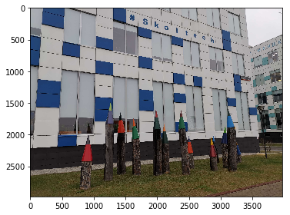
Image binarization
How to select a threshold for image binarization?
Manually select a reasonable value for 1 particular image
Estimate this value from an image. How can we do this?
Intro2CV: page ‹#›

Slide 5
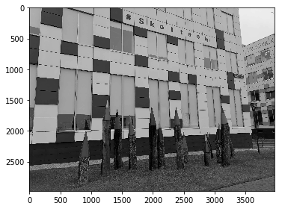
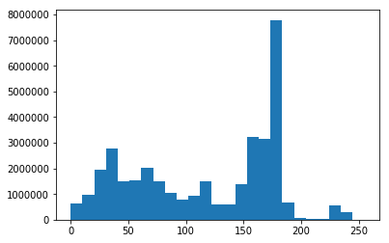
Image binarization
How to select a threshold for image binarization?
Manually select a reasonable value for 1 particular image
Estimate this value from an image. How can we do this? Analyzing the intensities!
Intro2CV: page ‹#›

Slide 6
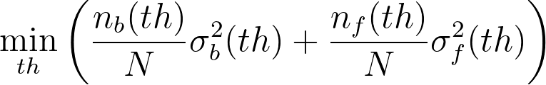
Image binarization - Otsu
Let us fix a threshold th
We can split all pixels into two classes based on its intensities
Background (less than th)
Foreground (more or equal than th)
n_{b} and n_{f} are the numbers of pixels in these classes
Now we look for the optimal threshold by minimizing the weighted intra class variance (σ_{b} and σ_{f} are stds of pixel intensities)

Slide 7
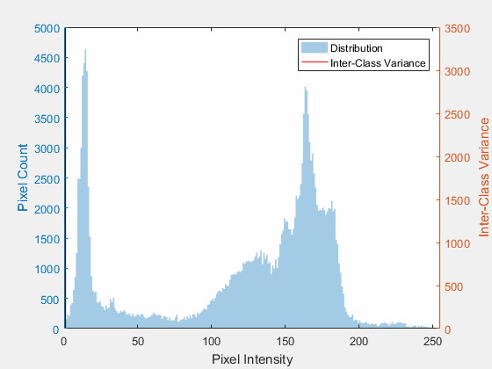
Image binarization - Otsu
The idea is to find the threshold th maximizing intraclass variance for background and foreground classes of pixels
Intro2CV: page ‹#›
Source: https://en.wikipedia.org/wiki/Otsu%27s_method

Slide 8
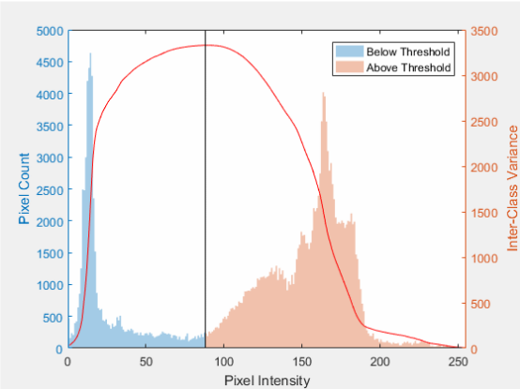
Image binarization - Otsu
The idea is to find the threshold th maximizing intraclass variance for background and foreground classes of pixels
Intro2CV: page ‹#›
Source: https://en.wikipedia.org/wiki/Otsu%27s_method

Slide 9
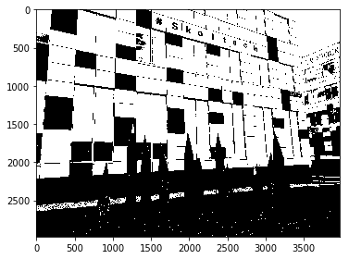
Image binarization - Otsu
Otsu thresholding can be considered as k-means clustering in 1D space
Intro2CV: page ‹#›

Slide 10
Image binarization - global thresholding
There are many other methods for selecting a global threshold
What are the drawbacks of this approach?
Intro2CV: page ‹#›

Slide 11
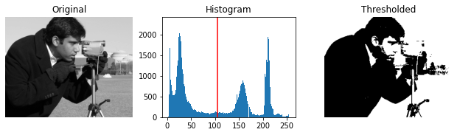
Image binarization - global thresholding
There are many other methods for selecting a global threshold
What are the drawbacks of this approach?
Sometimes the histogram is not bimodal
Based on https://scikit-image.org/docs/dev/auto_examples/applications/plot_thresholding.html?highlight=threshold_local
Intro2CV: page ‹#›

Slide 12
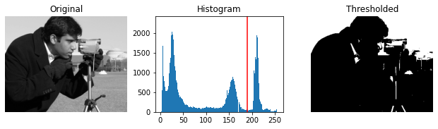
Image binarization - global thresholding
There are many other methods for selecting a global threshold
What are the drawbacks of this approach?
Sometimes the histogram is not bimodal
Based on https://scikit-image.org/docs/dev/auto_examples/applications/plot_thresholding.html?highlight=threshold_local
Intro2CV: page ‹#›

Slide 13
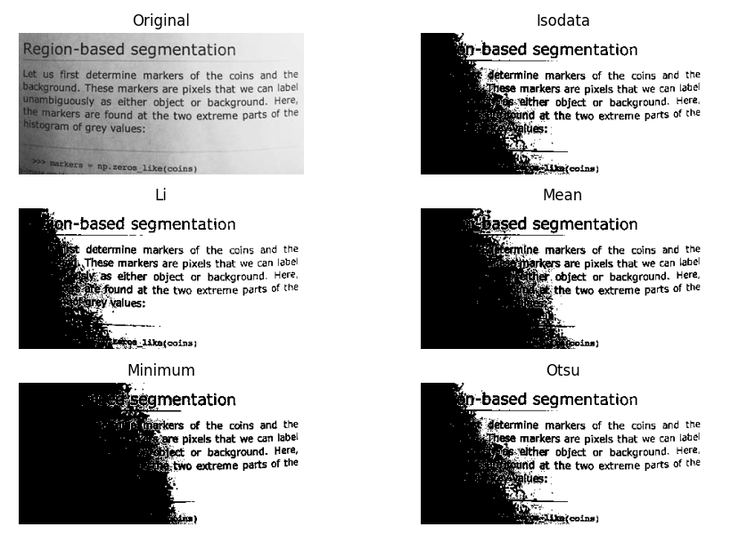
Image binarization - global thresholding
There are many other methods for selecting a global threshold
What are the drawbacks of this approach?
Sometimes the histogram is not bimodal
Different lightness brokes the idea
Source: https://scikit-image.org/docs/dev/auto_examples/segmentation/plot_thresholding.html
Intro2CV: page ‹#›

Slide 14
Image binarization
There are many other methods for selecting a global threshold
What are the drawbacks of this approach?
Sometimes the histogram is not bimodal
Different lightness brokes the idea
How can we fix it?
Intro2CV: page ‹#›

Slide 15
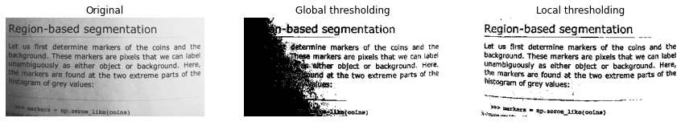
Image binarization
There are many other methods for selecting a global threshold
What are the drawbacks of this approach?
Sometimes the histogram is not bimodal
Different lightness brokes the idea
How can we fix it?
Look for a threshold locally!
Intro2CV: page ‹#›

Slide 16
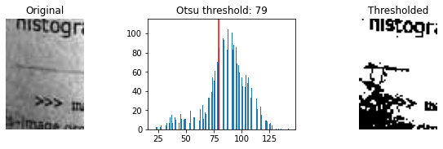
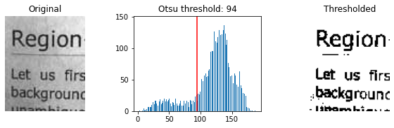
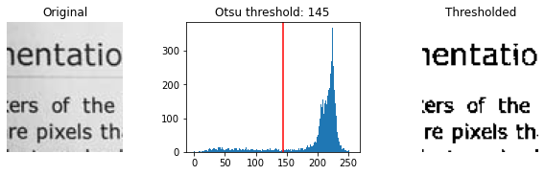
Image binarization - local thresholding
Look for a threshold locally!
Intro2CV: page ‹#›

Slide 17
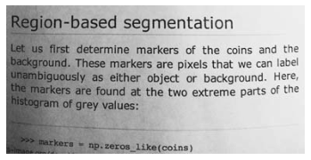
Image binarization - local thresholding
The algorithm
Select block_size (= the size of the filter)
Select a function to calculate a value within the block, e.g. mean or gaussian (= apply a mean/gaussian filter)
Compare the central pixel with the calculated statistic (adding a constant offset if needed) to make the decision about its class
More details can be found here: https://www.pyimagesearch.com/2021/05/12/adaptive-thresholding-with-opencv-cv2-adaptivethreshold/
Intro2CV: page ‹#›

Slide 18
Outline
Image binarization
Morphological operations
Contours in OpenCV

Slide 19
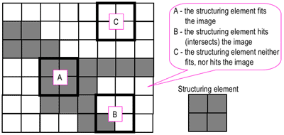
Morphology
Besides convolution, there are other useful windowed operations. The pipeline is simple
1. Convolve your image with a structuring elements (a simple predefined kernel such as 3x3 star or square)
2. Calculate min / max value for each window.
Source
Intro2CV: page ‹#›

Slide 20
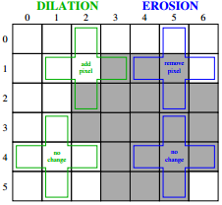
Morphology
Binary dilation - taking the maximal value in a window.
Binary erosion - taking the minimal value in a window.
Intro2CV: page ‹#›

Slide 21
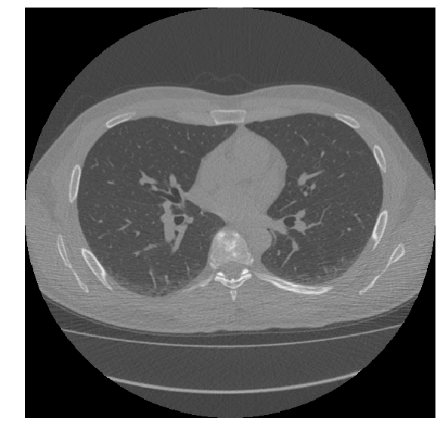
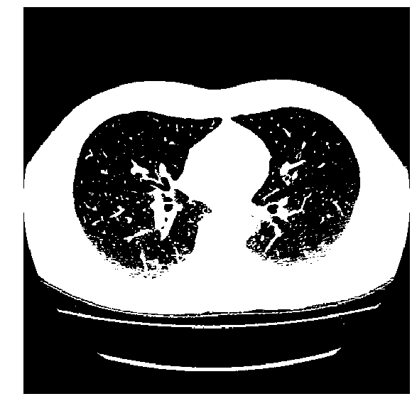
Morphology - chest CT example
Chest CT
Binarized chest CT
Black pixels - air; White ones - body, table
Intro2CV: page ‹#›

Slide 22

Morphology: dilation
Taking maximum in a window effectively makes all pixels in a neighbourhood of a white pixel also white.
Intro2CV: page ‹#›

Slide 23
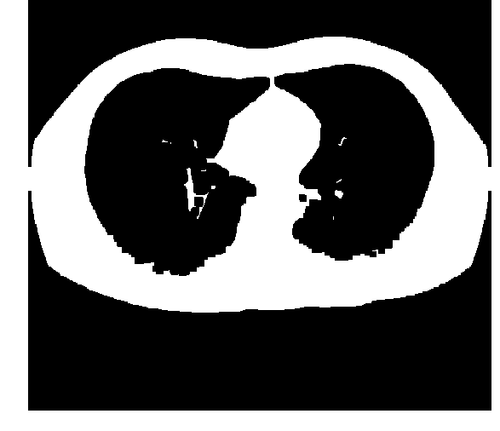
Morphology: erosion
Taking minimum in a window will do the opposite.
Intro2CV: page ‹#›

Slide 24

Morphology: closing
Applying dilation and erosion will close small holes.
Intro2CV: page ‹#›

Slide 25
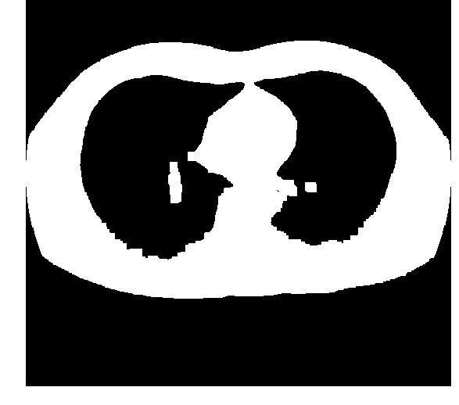
Morphology: opening
Applying erosion and dilation will remove small components.
Intro2CV: page ‹#›

Slide 26
Outline
Image binarization
Morphological operations
Contours in OpenCV

Slide 27
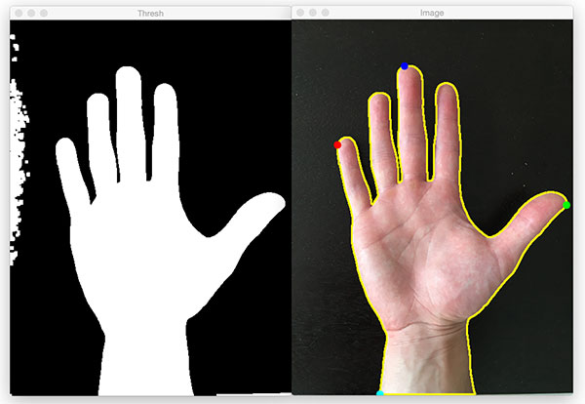
Contours
Intro2CV: page ‹#›

Slide 28
Contours
Contours are a powerful weapon in Computer Vision
Contour detection creates simple representation of 2d object mask
By dividing 2d image into list of contours it’s easier to iterate over regions
Intro2CV: page ‹#›

Slide 29

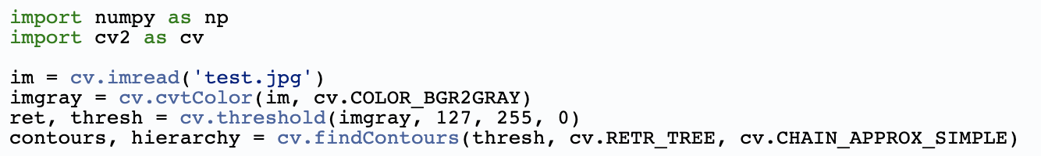
Contours
A contour is an array of dots of an object edge
Usually they are interpolated
So only extreme ones are left
Contours can be computed for a binary image (including edges)
Intro2CV: page ‹#›

Slide 30
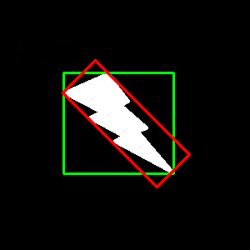

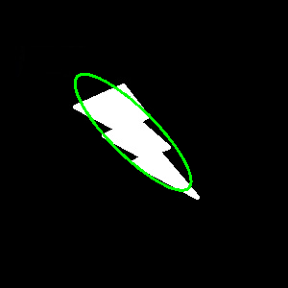
Contour features
cv2.boundingRect(cnt)
cv2.minAreaRect(cnt)
cv2.minEnclosingCircle(cnt)
cv2.fitEllipse(cnt)
And others
https://docs.opencv.org/master/dd/d49/tutorial_py_contour_features.html
Intro2CV: page ‹#›

Slide 31
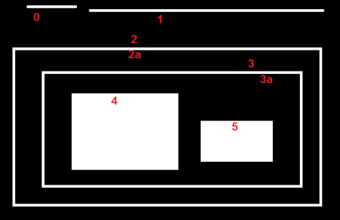
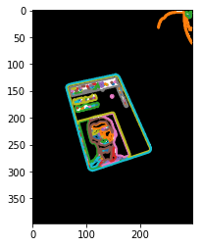
Contour features
Contours have internal hierarchy
https://docs.opencv.org/4.5.0/d9/d8b/tutorial_py_contours_hierarchy.html
Intro2CV: page ‹#›

Slide 32
Contour features
Contours have internal hierarchy
Options:
RETR_LIST Just all contours
RETR_EXTERNAL External(=outer) contours only
https://docs.opencv.org/4.5.0/d9/d8b/tutorial_py_contours_hierarchy.html
Intro2CV: page ‹#›

Slide 33
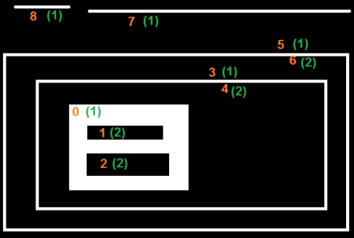
Contour features
Contours have internal hierarchy
Options:
RETR_CCOMP External contours for an object: 1 Internal ones: 2
https://docs.opencv.org/4.5.0/d9/d8b/tutorial_py_contours_hierarchy.html
Intro2CV: page ‹#›

Slide 34
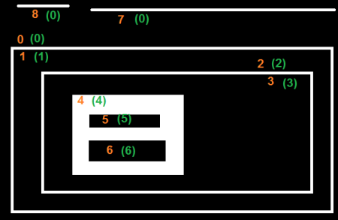
Contour features
Contours have internal hierarchy
Options:
RETR_TREE A full hierarchy!
https://docs.opencv.org/4.5.0/d9/d8b/tutorial_py_contours_hierarchy.html
Intro2CV: page ‹#›

Slide 35
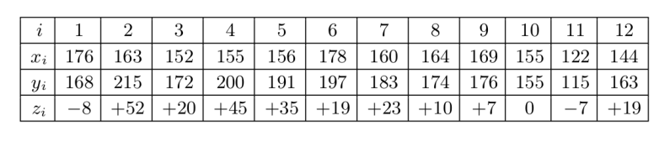
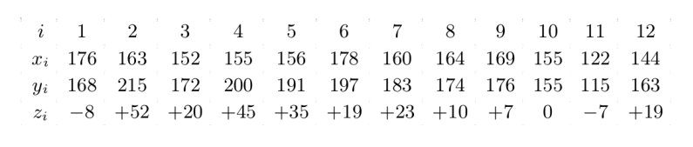
Morphology exercise 1: table removal
Assume we have an image (e.g. scan) of the table:
Then, with morphological operations,
we can remove the table lines and work with symbols only:
Goal: create the pipeline.
What other structures can we remove that way?
How can we modify solution if the table is not vertically aligned?
Intro2CV: page ‹#›

Slide 36
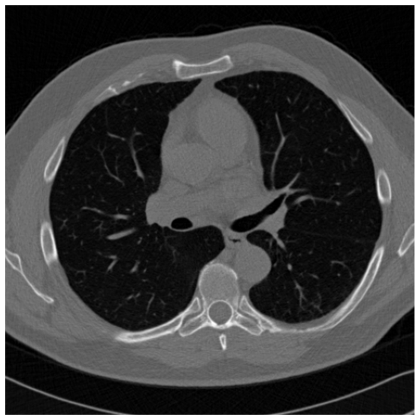
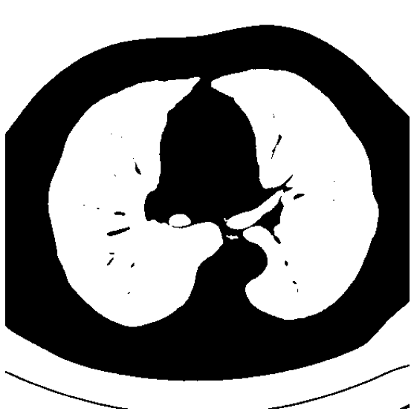

Morphology exercise 2: lung mask
Assume we have a chest CT scan.
Pixel intensities are given in Hounsfield units (HU)*. For example, the air ~= -1000.
Thresholding (< -250) gives us mask (1)
Goal:
create the pipeline
to obtain mask (2)
(1)
(2)
* https://en.wikipedia.org/wiki/Hounsfield_scale
Intro2CV: page ‹#›

